Slide 1
Design and Modeling of
Specialized Architectures
Phd Dissertation Defense
Yakun Sophia Shao
May 9th, 2016

Slide 2
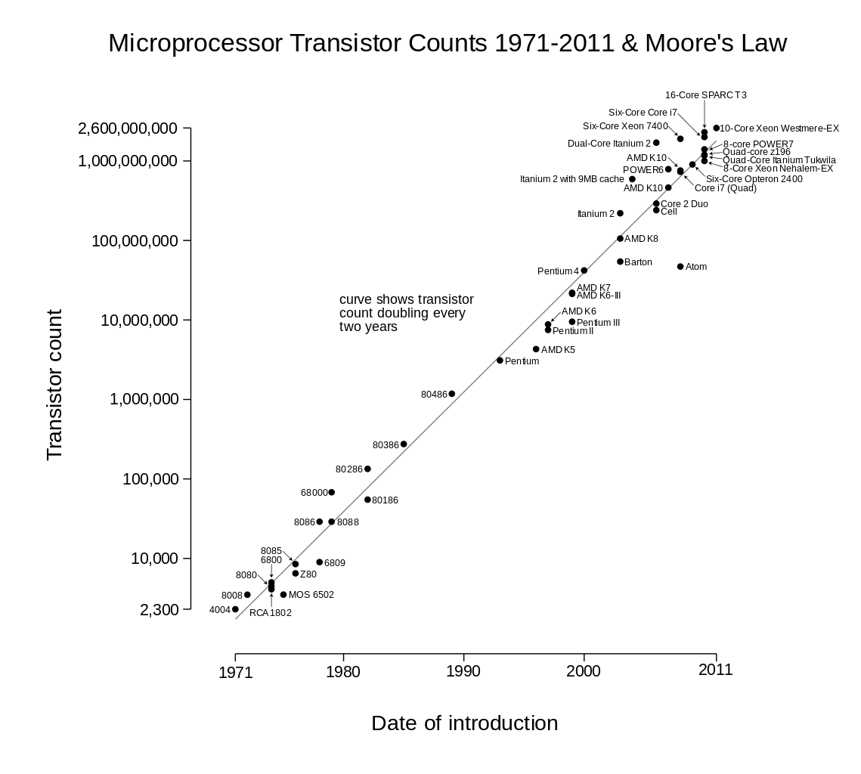
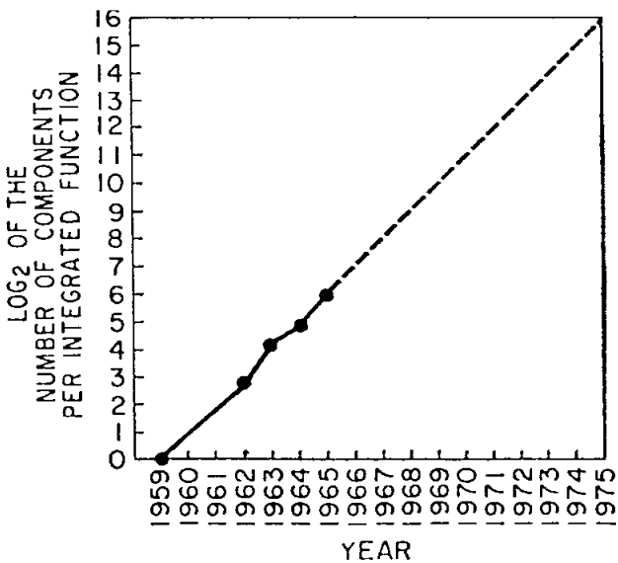
Moore’s Law

Slide 3
CMOS Scaling is Slowing Down
180 nm
130 nm
90 nm
65 nm
45 nm
32 nm
22 nm
14 nm
10 nm
http://www.anandtech.com/show/9447/intel-10nm-and-kaby-lake

Slide 4

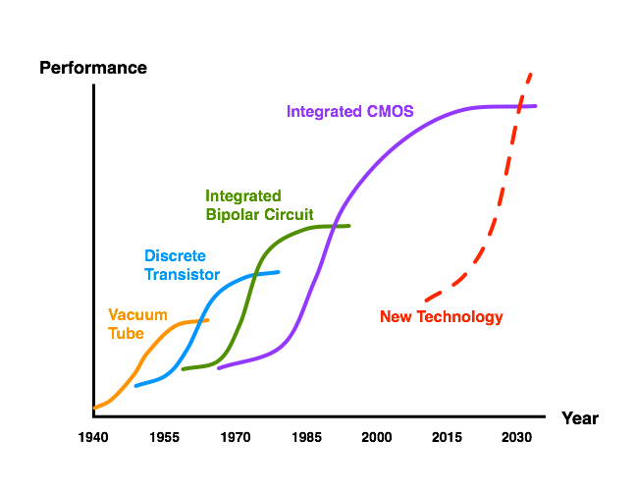
CMOS Technology Scaling
Technological
Fallow Period

Slide 5
Potential for Specialized Architectures
16 | Encryption
17 | Hearing Aid
18 | FIR for disk read
19 | MPEG Encoder
20 | 802.11 Baseband
[Zhang and Brodersen]

Slide 6
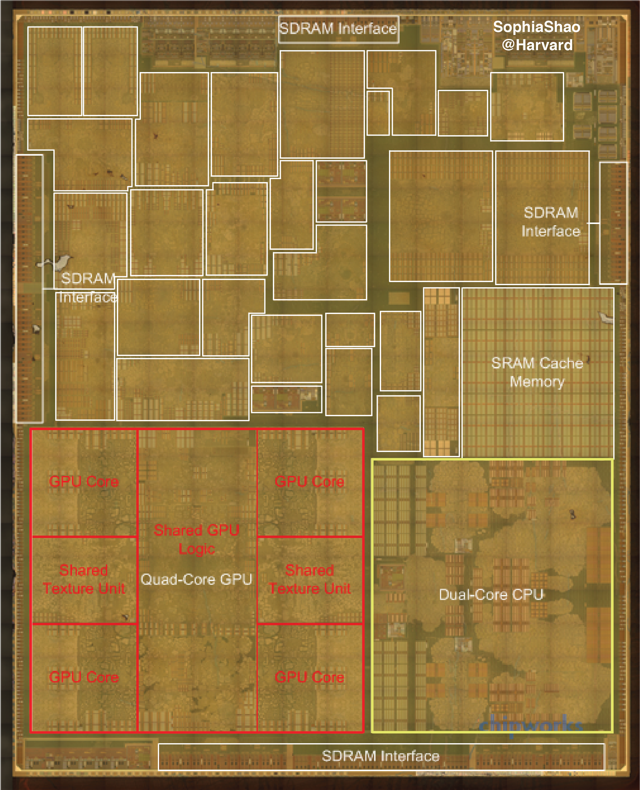
Cores, GPUs, and Accelerators:
Apple A8 SoC
Out-of-Core
Accelerators

Slide 7
Cores, GPUs, and Accelerators:
Apple A8 SoC
Out-of-Core
Accelerators

Slide 8
Cores, GPUs, and Accelerators:
Apple A8 SoC
Out-of-Core
Accelerators
Maltiel Consulting
estimates
Our estimates

Slide 9
Challenges in Accelerators
Flexibility
  Fixed-function accelerators are only designed for the target applications.
Programmability
  Today’s accelerators are explicitly managed by programmers.

Slide 10
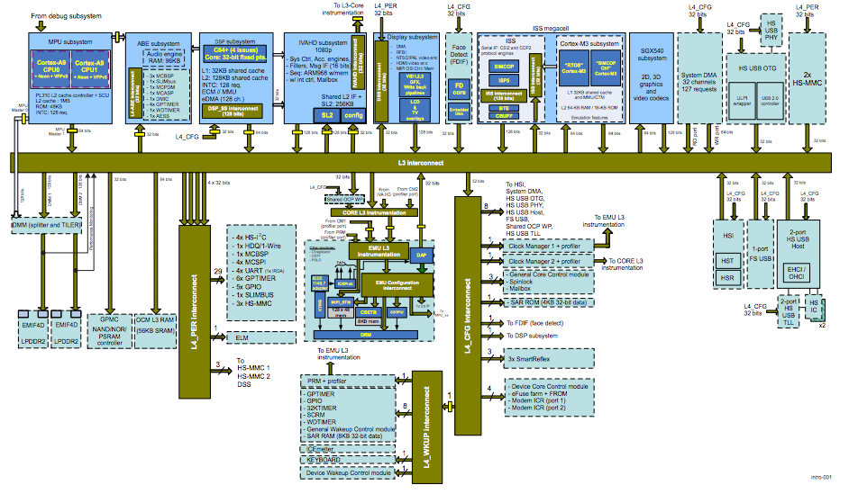
Today’s SoC
OMAP 4 SoC

Slide 11
Today’s SoC
ARM Cores
Audio
DSP
Video
DSP
Face
Imaging
GPU
DMA
USB
SD
System Bus
USB
DMA
Secondary
Bus
Secondary
Bus
Tertiary
Bus
OMAP 4 SoC

Slide 12
Challenges in Accelerators
Flexibility
  Fixed-function accelerators are only designed for the target applications.
Programmability
  Today’s accelerators are explicitly managed by programmers.
Design Cost
  Accelerator (and RTL) implementation is inherently tedious and time-consuming.

Slide 13
Today’s SoC
GPU/DSP
CPU
CPU
Mem
Inter-
face
Buses
Acc
Acc
Acc
Acc
Acc
Acc
Acc
Acc
Acc

Slide 14
Future Accelerator-Centric Architectures
GPU/DSP
Big
Cores
Small Cores
Memory
Interface
Shared Resources
Sea of Fine-Grained
Accelerators
How to decompose applications into accelerators?
How to rapidly design lots of accelerators?
How to design and manage the shared resources?
Flexibility
Design Cost
Programmability

Slide 15
Contributions
WIICA: Accelerator Workload Characterization [ISPASS’13]
MachSuite: Accelerator Benchmark Suite [IISWC’14]
GPU/DSP
Big Cores
Small Cores
Memory
Interface
Aladdin: Accelerator Pre-RTL, Power-Performance Simulator
[ISCA’14, TopPicks’15]
Shared Resources
Sea of Fine-Grained
Accelerators
Accelerator Design w/
High-Level Synthesis [ISLPED’13_1]
Research Infrastructures for Hardware Accelerators [Synthesis Lecture’15]
Instruction-Level Energy Model for Xeon Phi [ISLPED’13_2]
Accelerator-System
Co-Design
[Under Review]

Slide 16

Aladdin: A pre-RTL, Power-Performance Accelerator Simulator
Shared Memory/Interconnect
Models
Unmodified
C-Code
Aladdin
Power/Area
Accelerator
Specific
Datapath
Private L1/
Scratchpad
Accelerator Design
Parameters
(e.g., # FU, mem. BW)
Performance
“Accelerator Simulator”
Design Accelerator-Rich SoC
Fabrics and Memory Systems
“Design Assistant”
Understand Algorithmic-HW
Design Space before RTL
Flexibility
Programmability
Design Cost

Slide 17
Future Accelerator-Centric Architecture
GPU/DSP
Big Cores
Small Cores
Memory
Interface
Shared Resources
Sea of Fine-Grained
Accelerators

Slide 18
Future Accelerator-Centric Architecture
GPU/DSP
Big Cores
Small Cores
Memory
Interface
Shared Resources
Sea of Fine-Grained
Accelerators
Aladdin can rapidly evaluate large design space of accelerator-centric architectures.

Slide 19
Aladdin Overview
Optimization Phase
Optimistic
IR
Initial
DDDG
Idealistic
DDDG
C Code
Dynamic Data
Dependence Graph
(DDDG)
Performance
Activity
Program
Constrained
DDDG
Resource
Constrained
DDDG
Acc Design Parameters
Power/Area
Models
Power/Area
Realization Phase

Slide 20
Aladdin Overview
Optimization Phase
Optimistic
IR
Initial
DDDG
Idealistic
DDDG
C Code
Performance
Activity
Program
Constrained
DDDG
Resource
Constrained
DDDG
Acc Design Parameters
Power/Area
Models
Power/Area
Realization Phase

Slide 21
From C to Design Space
C Code:
for(i=0; i<N; ++i)
c[i] = a[i] + b[i];

Slide 22
From C to Design Space
IR Dynamic Trace
0. r0=0 //i = 0
r4=load (r0 + r1) //load a[i]
r5=load (r0 + r2) //load b[i]
r6=r4 + r5
store(r0 + r3, r6) //store c[i]
r0=r0 + 1 //++i
r4=load(r0 + r1) //load a[i]
r5=load(r0 + r2) //load b[i]
r6=r4 + r5
store(r0 + r3, r6) //store c[i]
r0 = r0 + 1 //++i
…
C Code:
for(i=0; i<N; ++i)
c[i] = a[i] + b[i];

Slide 23
From C to Design Space
Initial DDDG
IR Trace:
0. r0=0 //i = 0
1. r4=load (r0 + r1) //load a[i]
2. r5=load (r0 + r2) //load b[i]
3. r6=r4 + r5
4. store(r0 + r3, r6) //store c[i]
5. r0=r0 + 1 //++i
6. r4=load(r0 + r1) //load a[i]
7. r5=load(r0 + r2) //load b[i]
8. r6=r4 + r5
9. store(r0 + r3, r6) //store c[i]
10.r0 = r0 + 1 //++i
…
0. i=0
5. i++
1. ld a
2. ld b
C Code:
for(i=0; i<N; ++i)
c[i] = a[i] + b[i];
10. i++
6. ld a
7. ld b
3. +
11. ld a
12. ld b
8. +
4. st c
13. +
9. st c
14. st c

Slide 24
From C to Design Space
Idealistic DDDG
IR Trace:
0. r0=0 //i = 0
1. r4=load (r0 + r1) //load a[i]
2. r5=load (r0 + r2) //load b[i]
3. r6=r4 + r5
4. store(r0 + r3, r6) //store c[i]
5. r0=r0 + 1 //++i
6. r4=load(r0 + r1) //load a[i]
7. r5=load(r0 + r2) //load b[i]
8. r6=r4 + r5
9. store(r0 + r3, r6) //store c[i]
10.r0 = r0 + 1 //++i
…
0. i=0
0. i=0
5. i++
10. i++
5. i++
1. ld a
2. ld b
1. ld a
2. ld b
6. ld a
7. ld b
11. ld a
12. ld b
C Code:
for(i=0; i<N; ++i)
c[i] = a[i] + b[i];
10. i++
6. ld a
7. ld b
3. +
3. +
8. +
13. +
11. ld a
12. ld b
8. +
4. st c
4. st c
9. st c
14. st c
13. +
9. st c
14. st c

Slide 25
From C to Design Space
Optimization Phase: C->IR->DDDG
Include application-specific customization strategies.
Node-Level:
  Bit-width Analysis
  Strength Reduction
  Tree-height Reduction
Loop-Level:
  Remove dependences between loop index variables
Memory Optimization:
  Memory-to-Register Conversion
  Store-Load Forwarding
  Store Buffer

Slide 26
From C to Design Space
One Design
Resource Activity
Idealistic DDDG
0. i=0
5.i++
10. i++
15. i++
0. i=0
1. ld a
2. ld b
6. ld a
7. ld b
11. ld a
12. ld b
16. ld a
17. ld b
1. ld a
2. ld b
MEM
MEM
3. +
+
3. +
8. +
13. +
18. +
4. st c
MEM
4. st c
9. st c
14. st c
19. st c
+
5.i++
6. ld a
7. ld b
MEM
MEM
Acc Design Parameters:
Memory BW <= 2
1 Adder
+
8. +
9. st c
MEM
Cycle

Slide 27
From C to Design Space
Another Design
Resource Activity
Idealistic DDDG
+
0. i=0
5.i++
10. i++
15. i++
0. i=0
5.i++
1. ld a
2. ld b
6. ld a
7. ld b
11. ld a
12. ld b
16. ld a
17. ld b
1. ld a
2. ld b
6. ld a
7. ld b
MEM
MEM
MEM
MEM
+
+
3. +
8. +
13. +
18. +
3. +
8. +
4. st c
9. st c
14. st c
19. st c
4. st c
9. st c
MEM
MEM
+
+
10. i++
15. i++
Acc Design Parameters:
Memory BW <= 4
2 Adders
11. ld a
12. ld b
16. ld a
17. ld b
MEM
MEM
MEM
MEM
+
+
13. +
18. +
14. st c
19. st c
MEM
MEM
Cycle

Slide 28
From C to Design Space
Realization Phase: DDDG->Estimates
Constrain the DDDG with program and user-defined resource constraints
Program Constraints
  Control Dependence
  Memory Ambiguation
Resource Constraints
  Loop-level Parallelism
  Loop Pipelining
  Memory Ports

Slide 29
From C to Design Space
Power-Performance per Design
Acc Design Parameters:
Memory BW <= 4
2 Adders
Power
Acc Design Parameters:
Memory BW <= 2
1 Adder
Cycle

Slide 30
From C to Design Space
Design Space of an Algorithm
Power
Cycle

Slide 31
Aladdin Validation
Aladdin
C Code
Power/Area Performance
Design
Compiler
Verilog
Activity
ModelSim

Slide 32
Aladdin Validation
Aladdin
C Code
Power/Area Performance
RTL Designer
Design
Compiler
Verilog
Activity
HLS C Tuning
Vivado
HLS
ModelSim

Slide 33
Aladdin Validation

Slide 34
Aladdin Validation

Slide 35
Algorithm-to-Solution Time
 | Hand-Coded RTL | C-to-RTL
Programming Effort | High | Medium
RTL Generation | Designer Dependent | 37 mins
RTL Simulation | 5 mins
RTL Synthesis | 45 mins
Time to Solution per Design | 87 mins
Time to Solution (36 Designs) | 52 hours

Slide 36
Algorithm-to-Solution Time
 | Hand-Coded RTL | C-to-RTL | Aladdin
Programming Effort | High | Medium | N/A
RTL Generation | Designer Dependent | 37 mins
RTL Simulation | 5 mins
RTL Synthesis | 45 mins
Time to Solution per Design | 87 mins |  | 1 min
Time to Solution (36 Designs) | 52 hours |  | 7 min

Slide 37

Aladdin enables pre-RTL simulation of accelerators with the rest of the SoC.
GPU
DRAMSim2
GPGPU-Sim
Big
Cores
gem5
...
Small Cores
gem5
…
Memory
Interface
Shared Resources
Cacti/Orion2
Sea of Fine-Grained
Accelerators

Slide 38
Accelerator Integration
Lane 0
Lane 1
Lane 2
Lane 3
Lane 4
CPU 0
CPU 1
ACC
L1 $
L1 $
SPAD Interface
MEM
ARR 0
ARR 1
L2 $
BUF 0
BUF 1
System Bus
MC
Transfer Descriptors
Channel Selection
SRC ADDR
DEST ADDR
LENGTH
CHAN 0
CHAN 3
DRAM
DMA

Slide 39
Compute is only a part of the story

Slide 40
Compute is only a part of the story
Accelerator-System Co-Design

Slide 41
Accelerator Integration
Lane 0
Lane 1
Lane 2
Lane 3
Lane 4
CPU 0
CPU 1
ACC
L1 $
L1 $
SPAD Interface
MEM
ARR 0
ARR 1
L2 $
BUF 0
BUF 1
System Bus
Lane 0
Lane 1
Lane 2
Lane 3
MC
Transfer Descriptors
Channel Selection
SRC ADDR
DEST ADDR
LENGTH
CHAN 0
ACC
CHAN 3
Cache Interface
DRAM
DMA
MEM
TLB
Cache

Slide 42
gem5-Aladdin: An SoC Simulator
Lane 0
Lane 1
Lane 2
Lane 3
Lane 4
CPU 0
CPU 1
ACC
L1 $
L1 $
SPAD Interface
MEM
ARR 0
ARR 1
L2 $
BUF 0
BUF 1
System Bus
Lane 0
Lane 1
Lane 2
Lane 3
MC
Transfer Descriptors
Channel Selection
SRC ADDR
DEST ADDR
LENGTH
CHAN 0
ACC
CHAN 3
Cache Interface
DRAM
DMA
MEM
TLB
Cache

Slide 43
gem5-Aladdin Validation
gem5-Aladdin
Flush
Latency
DMA
Latency
Acc Exe Latency
Application
ARM
Core
DMA
IP Block
Verilog
Kernel
Vivado
HLS
FPGA
Xilinx Zynq SoC

Slide 44
gem5-Aladdin Validation

Slide 45
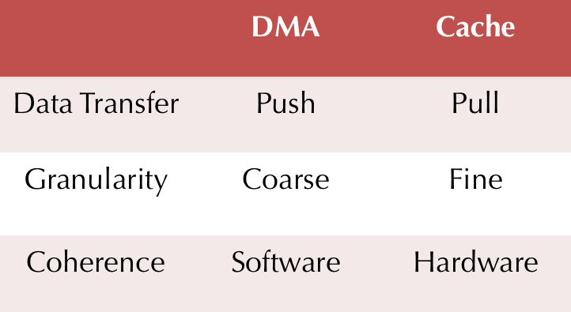
To DMA or To Cache?
Accelerator local memory

Slide 46
DMA or Cache

Slide 47
DMA or Cache

Slide 48
DMA or Cache

Slide 49
Conclusions
Architectures with 1000s of accelerators will be radically different; New design tools are needed.
We built Aladdin, an architectural level power, performance, and area simulator for accelerators.
We integrated Aladdin with gem5 to model the interactions between accelerators and the rest of the SoC.
These accelerator infrastructures open up opportunities for innovation on heterogeneous architecture designs.
Harvard University

Slide 50
Contributions
WIICA: Accelerator Workload Characterization [ISPASS’13]
MachSuite: Accelerator Benchmark Suite [IISWC’14]
GPU/DSP
Big Cores
Small Cores
Memory
Interface
Aladdin: Accelerator Pre-RTL, Power-Performance Simulator
[ISCA’14, TopPicks’15]
Shared Resources
Sea of Fine-Grained
Accelerators
Accelerator Design w/
High-Level Synthesis [ISLPED’13_1]
Research Infrastructures for Hardware Accelerators [Synthesis Lecture’15]
Instruction-Level Energy Model for Xeon Phi [ISLPED’13_2]
Accelerator-System
Co-Design
[Under Review]

Slide 51
Publications
Y.S. Shao, S. Xi, V. Srinivasan, G.-Y. Wei, D. Brooks, “An Holistic Approach to Accelerator-System Co-Design,” Under Review.
Y.S Shao and D. Brooks, “Research Infrastructures for Hardware Accelerators,” Synthesis Lectures on Computer Architecture, Nov 2015.
Y.S. Shao, B. Reagen, G.-Y. Wei, D. Brooks, “The Aladdin Approach to Accelerator Design and Modeling,” IEEE Micro TopPicks, May-June 2015.
Y.S. Shao, S. Xi, V. Srinivasan, G.-Y. Wei, D. Brooks, “Toward Cache-Friendly Hardware Accelerators,” SCAW’15.
B. Reagen, B. Adolf, Y.S. Shao, G.-Y. Wei, D. Brooks, “MachSuite: Benchmarks for Accelerator Design and Customized Architectures,” IISWC’14.
Y.S. Shao, B. Reagen, G.-Y. Wei, D. Brooks, “Aladdin: A Pre-RTL, Power-Performance Accelerator Simulator Enabling Large Design Space Exploration of Customized Architectures,” ISCA’14.
B. Reagen, Y.S. Shao, G.-Y. Wei, D. Brooks, “Quantifying Acceleration: Power/Performance Trade-Offs of Application Kernels in Hardware,” ISLPED’13.
Y.S. Shao and D. Brooks, “Energy Characterization and Instruction-Level Energy Model of Intel’s Xeon Phi Processor,” ISLPED’13.
Y.S. Shao and D. Brooks, “ISA-Independent Workload Characterization and its Implications for Specialized Architectures,” ISPASS’13.

Slide 52
Acknowledgement

Slide 53
Thanks!

